Slide 1
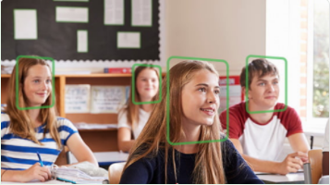
AI-POWERED HOURLY ATTENDANCE CAPTURING SYSTEM

Slide 2
Introduction
This project focuses on creating an automated system that takes the attendance of students on hourly bases using preinstalled cameras in the classes.
We make use of AWS services to marks the attendance, store the attendance in DB
To work with AWS Rekognition, DynamoDB, lambda functions and API Gateway.
Hands-on experience on Opencv.
To create a table in AWS Database
Work with Http Requests
Create Rest APIS
Work with Flask
Integrate Web App with AWS services

Slide 3
1.Data collection
As we are building a face recognition based smart attendance system, we should acquire the images of students to train the machine.
So collect the images of all the students - one image for a student is suffice
For this project, we have collected the images of Sehwag, Ganguly, and Kapil dev.

Slide 4
2.Configure IAM User
Give access to the following policies.
1. AWS lambda full access
2.AmazonDynamoDBFullAccess
3.AmazonRekognitionFullAccess
4.AdministrationFullAccess
5.AmazonAPIGatewayAdministrator

Slide 5
3.Create S3 Bucket
Search for S3 service from search and click on it, will be directed to Amazon S3 dashboard.
Click on Create bucket > Give a name for your bucket in the column Bucket name >select the region as US East (Ohio) & click on Next.
Disable the checkbox Block all public access & select the, I acknowledge checkbox and scroll down.
Now select manage system permissions to Grant Amazon S3 Log Delivery group write access to this bucket and click on Next.
Now click on Create bucket, so that bucket will created successfully.
Open on the created bucket and click on Upload
Click on Add files and upload your collected dataset images.

Slide 6
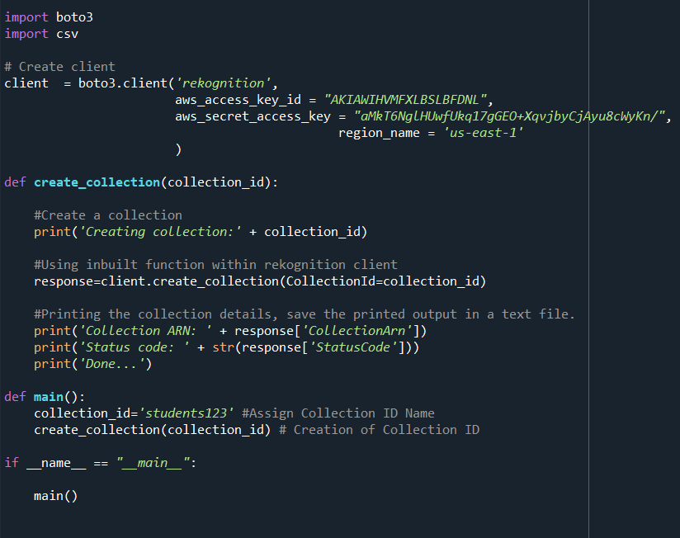
4.Searching faces in a collection
create collection
Import boto3 & CSV libraries using commands.
Creating a client for rekognition service

Slide 7
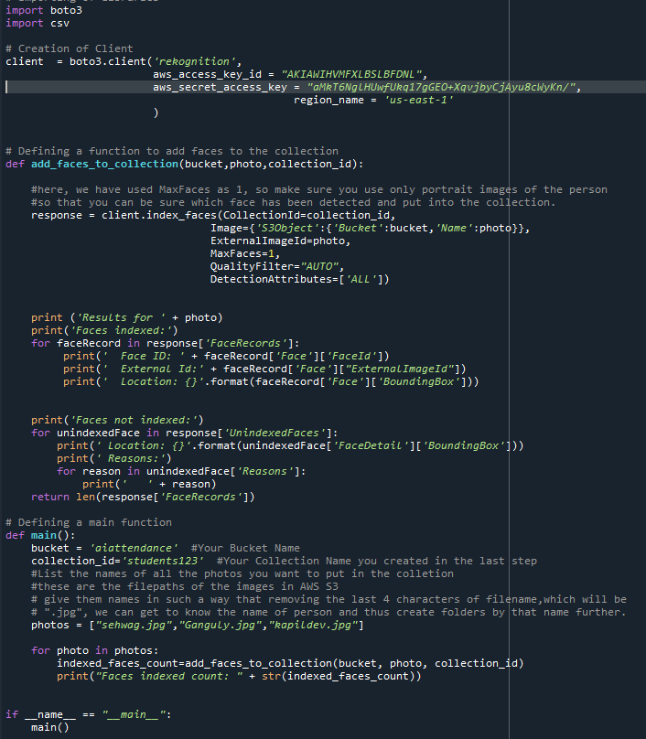
Create Facial Features For Collection ID
Import the libraries and create a client with your service credentials.
Defining a function to add the faces to the collection

Slide 8
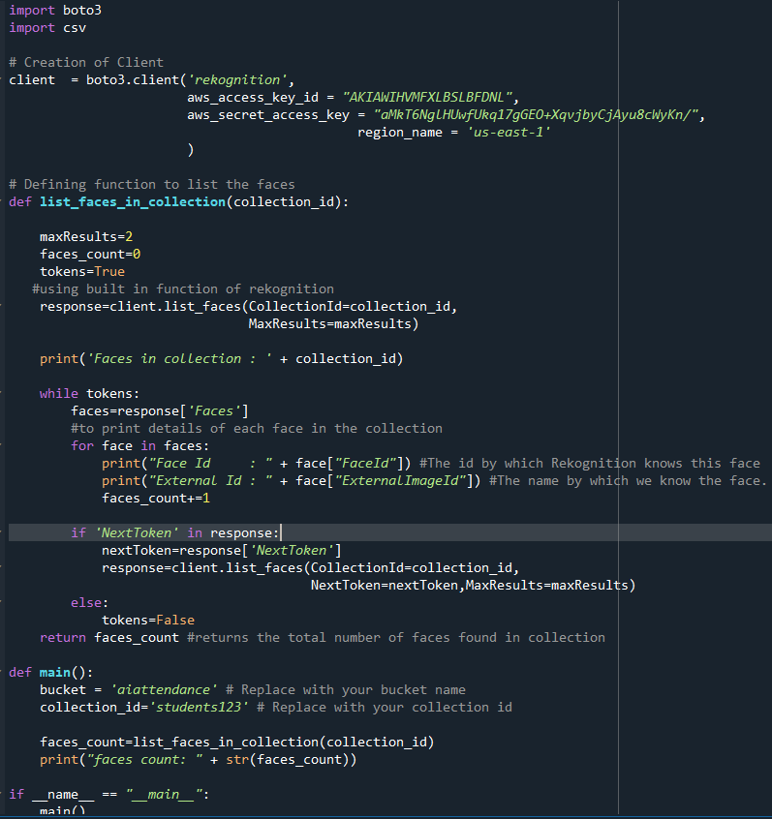
Listing Faces From Collection
The listing faces from the collection describe the face properties such as the bounding box, face ID, image ID of the input image, and external image ID that you assigned
The function will list all the faces stored in the server container in the form of collection id

Slide 9
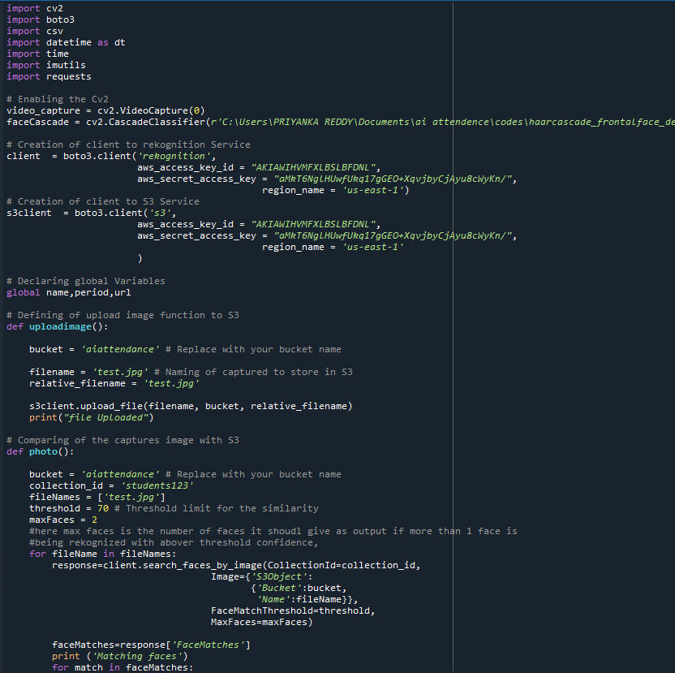
Comparing Captured Image With Stored Image
Now that We have stored the facial information in the collections, lets use this information to compare the image coming from a video frame or a new picture
code for video streaming

Slide 10
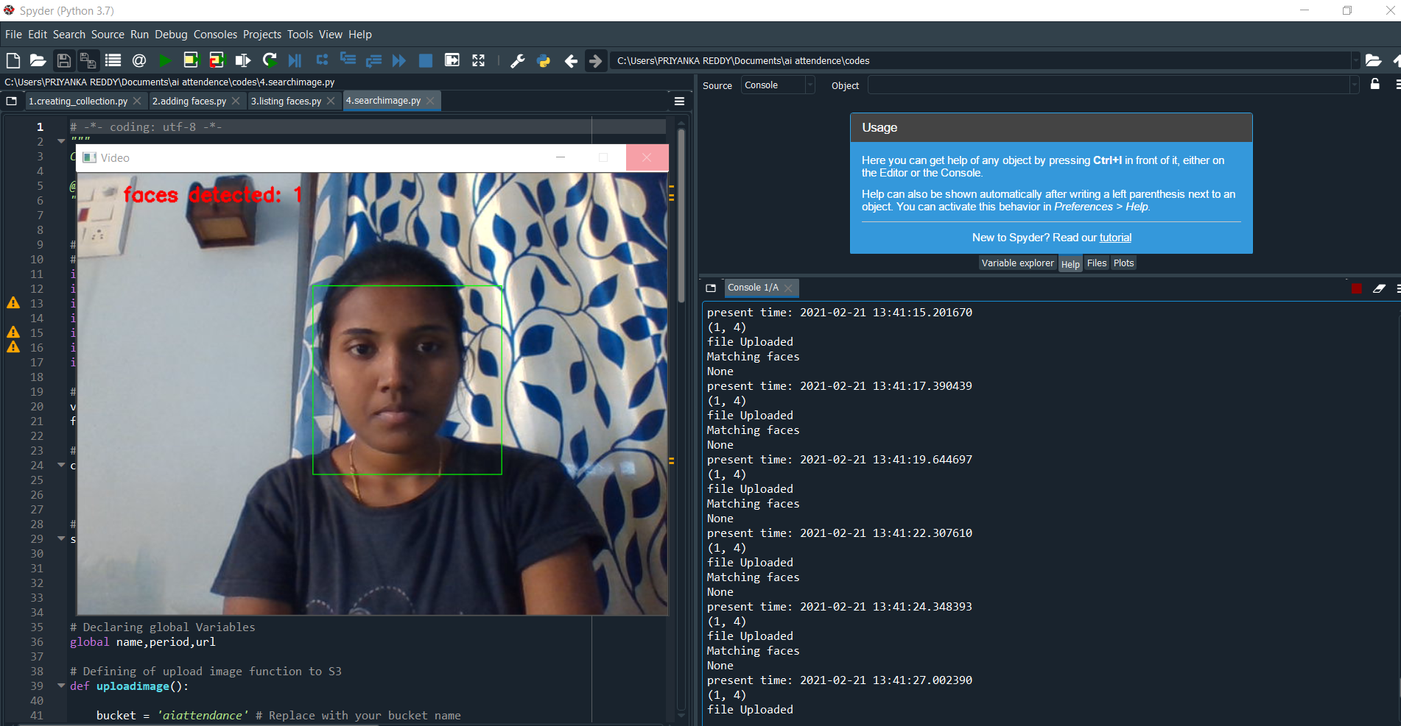
Output

Slide 11
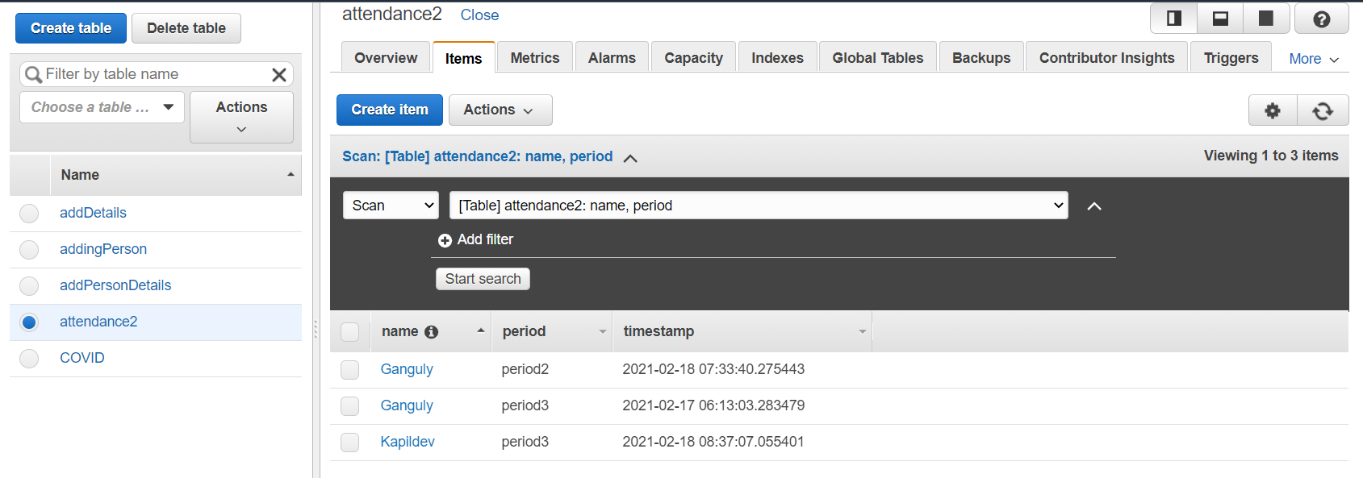
5.Insert Attendance Into DynamoDB Through API Gateway
Create Dynamodb Table
DynamoDB Service from the services & click on it, so that you will be directed to DynamoDB Dashboard.
Now, assign Table name as attendance2 & Primary Key as name, then click on Create to create the table.
We are done with the creation of the table.

Slide 12
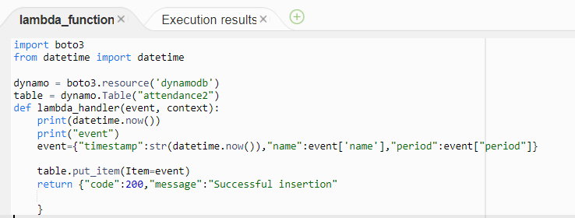
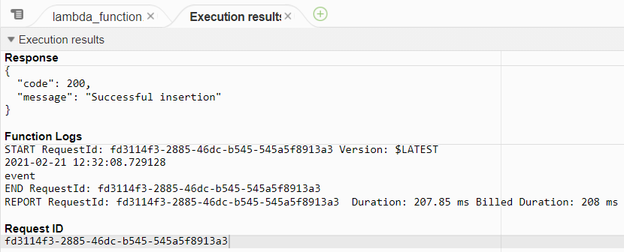
Create Lambda Function
lambda function service under the compute services of AWS Console Service.
Once the lambda function is opened, click on the Create function
Now, select function as Author from scratch, give a name to the function in the function name column & select the Runtime as Python 3.8, scroll down and click on Create function.
After the lambda function is created, scroll down to the coding window and write the below code and click on deploy.

Slide 13
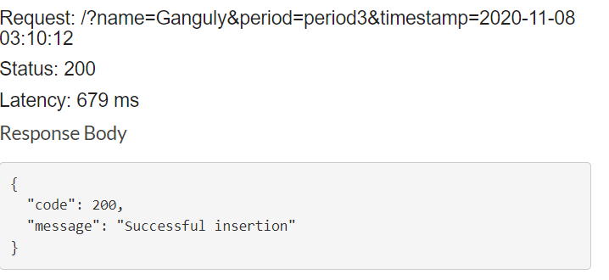
create an API
the API Gateway service under the Networking & Content Delivery service of AWS Console.
Once, API Gateway service is opened, click on Create API
Now, scroll down. Under REST API click on Build
Select as New API & give a name to API name and click on Create API.
Once the API is created, click on Actions & select Create Method
Now, select GET method and click on Right symbol.
Once the method is created, select the Integration type as Lambda Function & select the Lambda Function of your created function name, then click on Save & click on OK in the new prompted window.
Now, click on Method Request,click on URL Query String Parameters, then click on Add query string and give input names and click on Right Tick Symbol for every input to save.
from the created API Dashboard, click on Integration Request to integrate with lambda function in the json format.
scroll down & click on Mapping templates, in the Content-type type application/json and click on right tick to get the empty text box , type the below code and click on save.
{ "name":"$input.params('name')",
"period":"$input.params('period')"
“timestamp”:$input.params(‘timestamp’)”}
Go back and click on Test Now, give some inputs in the Query Strings as below, scroll down & click on Test as shown to test manually.
If you get the Response Body as Successful Insertion, your API is ready to deploy.

Slide 14
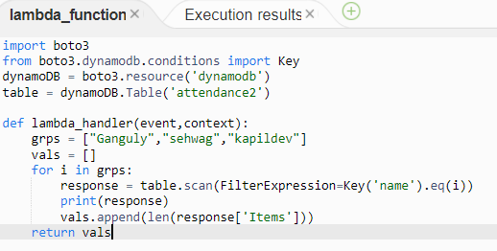
Building an Flask Application
create lambda function
go to Lambda function, click on Create function, and give a name to function, select the Runtime as Python 3.8 and change the permissions as shown below then scroll down & click on Create function.
Once the Lambda function is created, write the code shown below, to get the details form the DynamoDB.

Slide 15
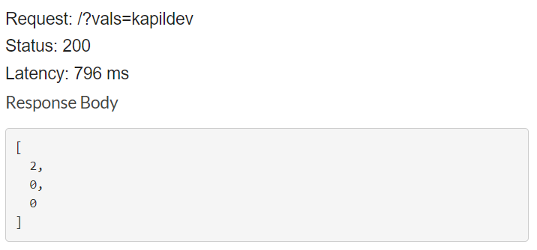
Create An API
same process should be done as previous API created(attendance api )
click on Integration Request and go to Mapping Templates and type the Content-Type as application/json, then write the below code & click on Save.
{ “vals”:”$input.params(‘vals’)”}

Slide 16
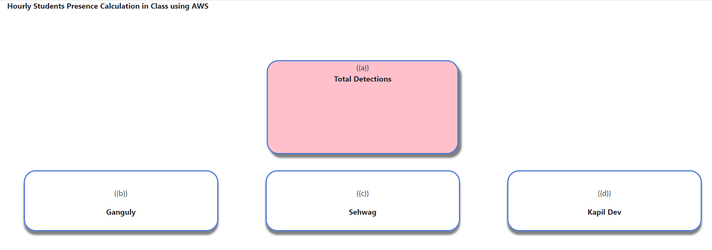
BUILD HTML CODE
To showcase the attendance on the User interface we must build HTML Pages
let us build an HTML page
Create an html page similar to below, according to our user interface.
output is as shown in figure

Slide 17
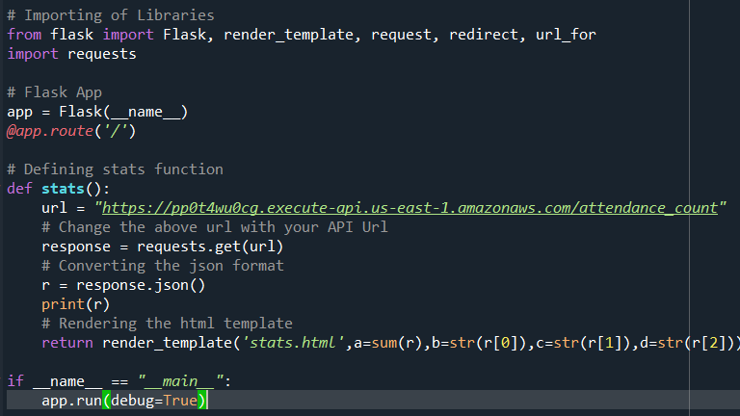
Build Python Code
Now, server side scripting code

Slide 18
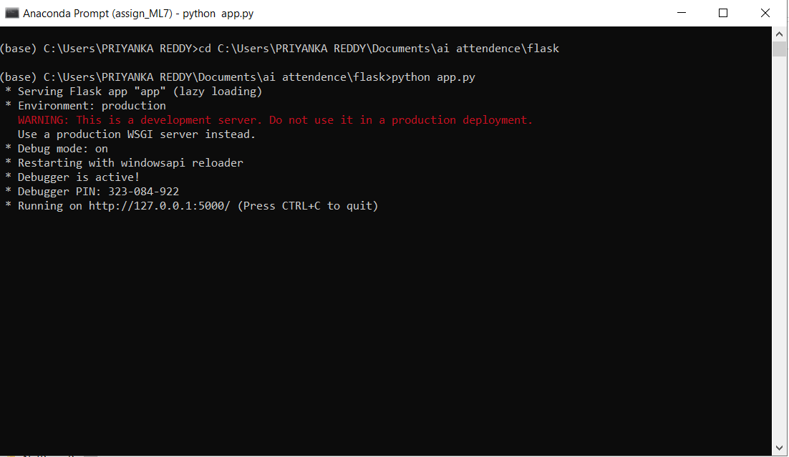
Run the app
Open anaconda prompt from the start menu.
Navigate to the folder where your app.py resides.
Now type “python app.py” command.
It will show the local host where your app is running on http://127.0.0.1.5000/
Copy that localhost URL and open that URL in the browser. It does navigate you to where you can view your web page.
application

Slide 19
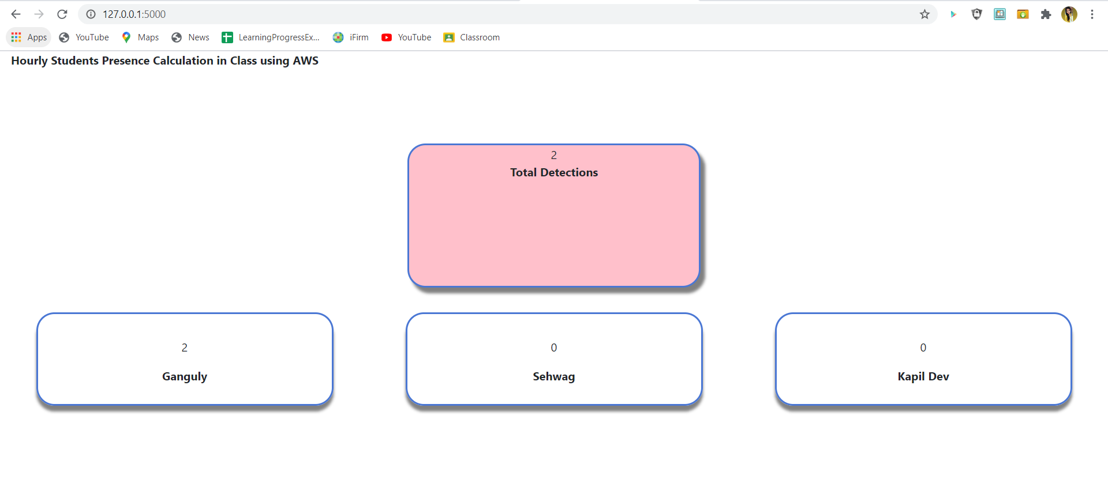
Output
1.Enter the url in the browser to check the output.
2.The output will look like as below.

Slide 20
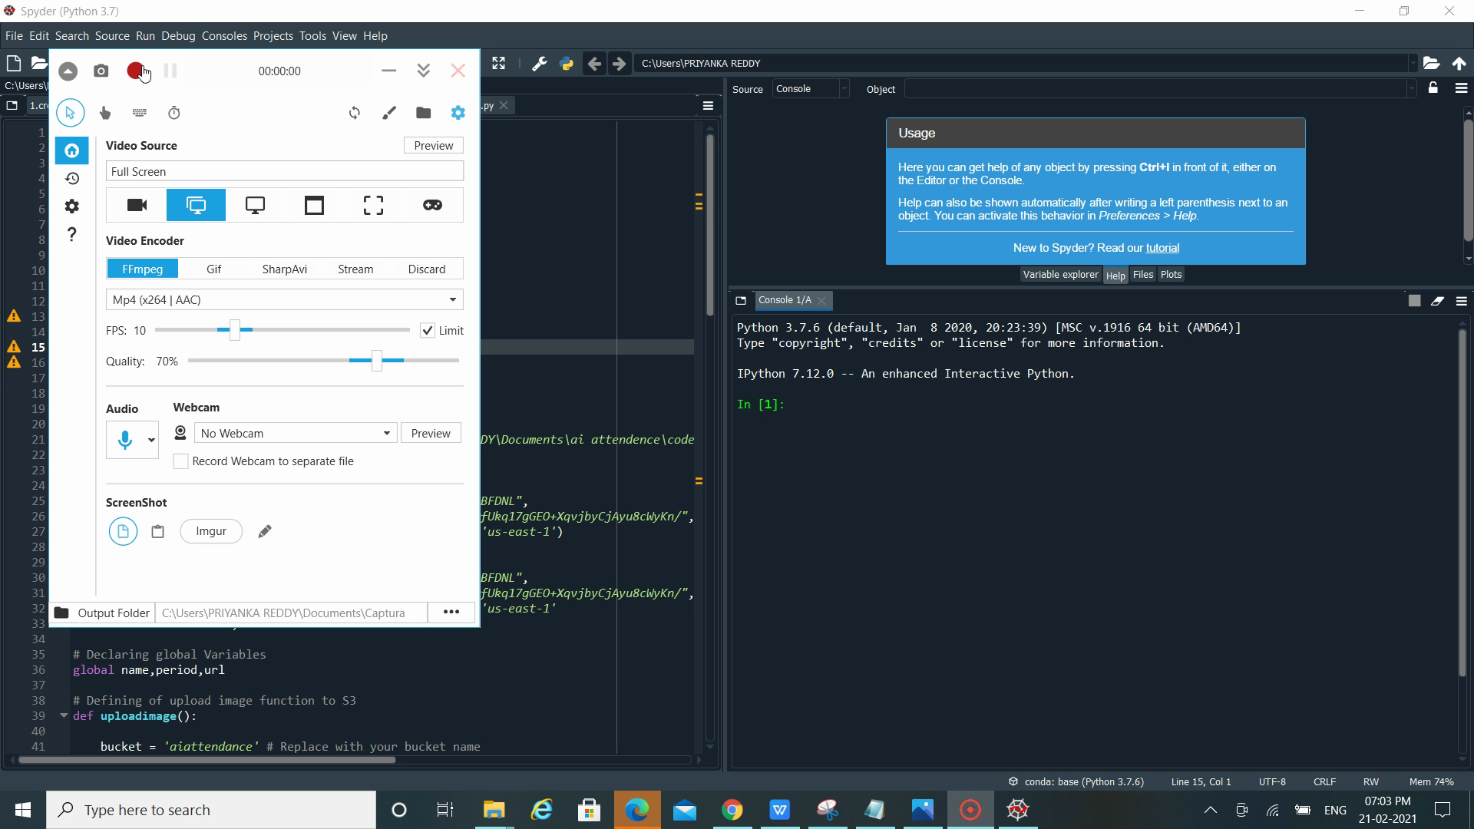
output video

